Slide 1
Social Organization
workplace courtesy

Slide 2
What does face means?
It is defined by sociologist Goffman as an image of the self which depends on both the rules and values of a particular society and the situation the social interaction is embedded in.
It hence mirrors the way a person wants to be perceived by others in his surrounding space.

Slide 3
The need to fulfil one's own desires is described as pride.
Example? What could be described as pride in school? What about at work?
One's emotional and physical attitude in social interaction is described as dignity.
Example? What could be described as dignity in school? What about work?
An individual's duties towards the society are defined as honour.
Example?

Slide 4
The positive face is defined as the individual desire of a person that his/ her personality is appreciated by others. Furthermore, this includes the way a person wants to be perceived by his/ her social group. One example for positive face is the appreciation of individual achievements. According to this definition, a painter would, for instance, desire other people's appreciation of his/ her paintings.
Negative face describes the basic personal rights of an individual, including his/ her personal freedom as well as freedom of action. One's negative face is a neglection of all factors which represent a threat towards individual rights. One popular example is the freedom of speech, which includes one's need not to be interrupted by others while speaking.

Slide 5
 | Face management | Sociality rights management
Personal angle | Quality face | Equity rights
Social angle | Identity face | Association rights
Notes:
Rebadging positive face as impression management
quality face - our desire for people to evaluate us positively in terms of our positive qualities (you're a good person)
identity face - our desire for people to acknowledge our social identities (group roles, social roles) (you're in a good group)
And negative face as ‘sociality rights’
Equity rights - belief that we shouldn't be treated unfairly
Cost-benefit - keeping costs and benefits in balance through reciprocity
Autonomy-imposition - how much other people impose on us
Association rights - belief that we have the right to associate in certain ways with certain people
Includes affective association/dissociation (extent to which we share feelings)

Slide 6
quality face - you're a good person
identity face - you're in a good group
Equity rights - belief that we shouldn't be treated unfairly
Association rights –belief that we have the right to associate in certain ways with certain people. Includes affective association/dissociation

Slide 7
Ordering your secretary to do something not in their job description, such as doing your washing
Notes:
How do you feel about this example?
This order affects the secretaries equity rights, because it doesn’t give them an option, and violates the right to a fair treatment.
This affects the secretaries identity and relational face, because it breaks the bounds on their social role in this situation, and their quality face, because it can be seen as devaluing their positive attributes.

Slide 8
You have recently graduated in statistics.
Your manager, whom you respect and admire, requests that you help on a new project working directly with them on a topic where they say your statistical skills will be invaluable.
Notes:
How do you feel about this request?
So requests can also be face-flattering. This one flatters quality face because it relates to your abilities as a statistician, and identity and relational face because it relates to your relationship with your manager.

Slide 9
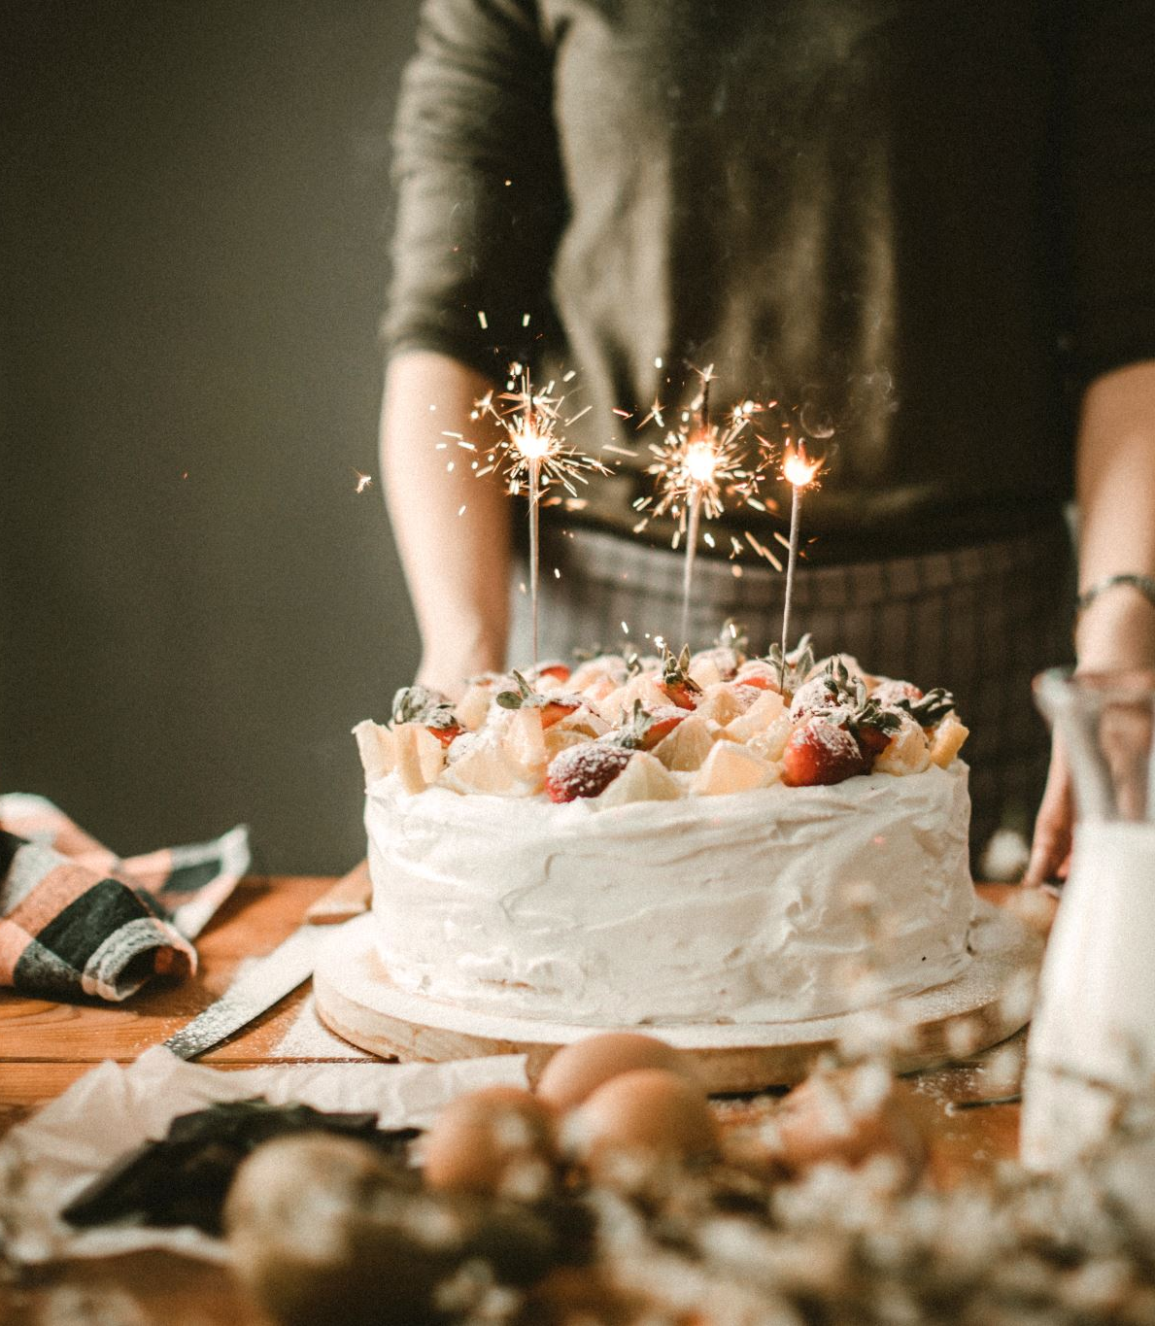
It is your birthday coming up, but your plans have fallen through. The day before your party, you ask your best friend (who you’ve been friends with since high school) to bake you a cake for your birthday party. You know she loves to bake cakes.
Notes:
Where does this request flatter or threaten Spencer-Oatey’s face and rights?

Slide 10
Humor or Insult?

Slide 11
The speaker/target/recipient interplay
The language dimension: linguistic mechanisms and/or discursive strategies used by speakers
The different pragmatic functions
The interactional dimension
Notes:
4 different aspects to consider when discussing humour

Slide 12



The speaker/target/recipient interplay
Notes:
When do you use humour? To make fun of your friend? Or to make fun of someone/something with your friend
The situation in which a humorous utterance takes place can be described in terms of the participants, consisting of a speaker, one or several recipients (or audience) and a target. In this context, the target is who or what is being made fun of. It can be a third party or even an abstract entity (an institution, an ideology), or it can coincide with the speaker or the recipient/addressee.
If it coincides with the speaker, we can call this self-oriented (previous work has sometimes called it self-deprecating, or auto-derision but these terms leave out the option of saying positive things).
If the target coincides with someone else, it can be called other-directed, which can be broken down into recipient directed or third party humour.

Slide 13
 | Australian English (35 examples) | French (30 examples)
Self-oriented | 14 (40%) | 12 (40%)
Other-directed
Recipient | 16 (46%) | 5 (17%)
Third Party | 5 (14%) | 13 (43%)

Slide 14
L j’te laisse fermer la porte pa’ce que:/
S ouais c’est que’que chose que j’peux encore faire
L c’toujours un peu étroit dans c’couloir
(1.1)
S t’sais chez moi j’me cogne tout l’temps en fait ((rire))
L I’ll let you close the door ‘cos:/
S yeah I can just about manage that
L it’s always a bit narrow in this corridor
(1.1)
S oh look (.) at my place I’m always bumping into things ((laughter))
Notes:
The host (L) has just invited a guest in (S), but because of the narrowness of the corridor, cannot close the door past the guest.
What’s the goal of this humour? What could be face threatening? Whose face is threatened?
Notice here that the self-directed humour is used by the guest to cover up the hosts embarrassment at asking the guest to close the door, and again in (4) where S uses himself as the target to compensate for the face threatening act of the apology in line 3, to suggest that his home is just as small

Slide 15
The language dimension
Linguistic play
Implicit references
Use of incongruity
Alternative reality
Notes:
Linguistic play – puns, polysemy, rhyme, alliteration etc
Implicit references – shared knowledge between the participants
Use of incongruity – connecting two usually unconnected ideas
Alternative reality – (Hay’s 2001 fantasy humour from this weeks reading) a world where the normal rules do not apply, and often become exaggerated or absurd

Slide 16
Humour devices in general | Australian English 39 occurrences in 35 examples | French 34 occurrences in 30 examples
Linguistic play | 8 (20.5%) | 20 (58.5%)
Implicit references | 8 (20.5%) | 3 (9%)
Use of incongruity | 15 (38.5%) | 8 (23.5%)
Development of an internal logic, an alternative reality | 8 (20.5%) | 3 (9%)

Slide 17
S fantastic oh it smells delicious
K I think it’s next door’s cooking ((laughter))
G yeah (.) or the cat food
Notes:
Example of absurdist humour from the Australian conversations
Why making the joke? Whose face is threatened?
Note that the compliment is face-threatening to K, because it threatens her negative face by placing her in a situation where she is obligated to respond or reciprocate the compliment. As such, she deflects it.

Slide 18
Pragmatic functions
Solidarity?
Power?
Notes:
Solidarity and power aren’t always enough to describe humour, especially between friends, because a lot of the time it is to establish solidarity in some way– especially for third-party oriented humour. BUT, for participant-oriented humour (either speaker or recipient), it can have these functions in relation to face and face-threatening acts.->

Slide 19
Pragmatic functions
Threatens other’s face for the sake of humour
To repair a real or potential threat to the other’s face
In self-defence as a response to a perceived face threat (humorous or not)
Notes:
- Humour that threatens the other’s face for the sake of humour i.e., the face threat is a “by-product” of humour: face concerns are temporarily ignored for the sake of making others laugh. Many of these threats actually fall into the “mock” categories: they are “mock challenges”, “mock imitations”, “mock impoliteness”.
- Humour that is used to repair a real or potential threat to the other’s face, i.e. humour helps keep the interaction smooth although some form of face threat has occurred (an indiscreet question or a veiled criticism, for example, or a self-inflicted face threat from the previous speaker).
- Humour that is used in self-defence as a response to a perceived face threat (humorous or not), i.e. humour allows the speaker to “counter attack” while not showing any hurt, therefore protecting his/her positive face.

Slide 20
Interactional dimension
Response to a previous turn (which may or may not have been humorous)
Initiated in a first turn and the ensuing responses in the following turns (which may or may not be humorous)
Construction of whole collaborative humorous scenarios
Notes:
- Humour as a response to a previous turn. These are cases where humour occurs in the second turn of an adjacency pair. Some categories already imply such a position: retorts and repartees but also to a certain extent quips, wisecracks and other witticisms
- Humour initiated in a first turn and responses in the following turns--supportive strategies recipients are offering to the initial speaker to show their recognition, understanding and appreciation of the attempt at humour. They may, for example, laugh, contribute more humour, offer sympathy (as a response to self-deprecating humour), or fail to react.
- The construction of collaborative humorous scenarios that take on a “life of their own”. These may evolve from either of the two previous categories, but they are distinctive because they usually involve some form of escalation, with each speaker contributing more humour over several turns. If combined with the linguistic devices dimension, many of these scenarios can be classified under the label of fantasy humour, which Hay (2001: 62) describes as the “construction of humorous, imaginary scenarios or events”.

Slide 21
Hay’s framework
General
Solidarity
Psychological
Power
Defend
Cope
contextual
non-contextual
Share
BoundS
Other
Control
TeaseP
Highlight
TeaseS
Conflict
BoundP
Notes:
Above the line are functions, and below the line are strategies to achieve those functions

Slide 22
https://www.youtube.com/watch?v=x8Z6cmWCjKo
Notes:
Watch this video for the interactions and see if you can apply one of the frameworks discussed earlier. Can you discuss what happens in this video from the point of view of Béal and Mullan’s dimensions?

Slide 23
What kinds of humour are happening in this video?
Between Hamish and Andy?
Between Hamish and the apartment owner?
Between both Hamish and Andy and us as an audience?

Slide 24
Impoliteness

Slide 25
1. Intentional disruption of social harmony
Face
By saying unpleasant things to them
Rights
By denying them
what they want or imposing on them
Notes:
Attacking quality face by attacking the personal qualities of the Hearer
Attacking identity/relational face by attacking the groups that they other person belongs to, or people belonging to those groups.
Attacking equity rights by acting towards another person in a way where cost-benefit reciprocity is not maintained or acting towards another person in a way where their autonomy is violated.
Attacking association rights by deliberately speaking in a way that excludes the other person (by using language they don’t understand, by diverging from they way you’d normally interact with them, mock politeness, sarcasm)

Slide 26
2. Unintentional impoliteness and miscommunication

Slide 27
3. Mock impoliteness
apparent impoliteness which actually preserves social harmony

Slide 28


Notes:
Impoliteness can stem from the speaker deliberately attacking face or sociality rights of the hearer

Slide 29




Notes:
Or from the hearer perceiving the speaker as deliberately attacking the face or sociality rights of the hearer

Slide 30
 | H perceives attack | H doesn’t perceive attack
S intends attack | Rudeness | Miscommunication
S doesn’t intend attack | Miscommunication | Politeness

Slide 31
A and B are farmers. A sees B for the first time in a long while, and notices that B has put on some weight. A: How ya goin’ ya old bugger! See you’ve been feeding in a good paddock! A: Good afternoon sir, may I compliment you on how particularly well you’re looking.
Notes:
Is this polite? Impolite? Rude?
This is why the two definitions of politeness are important. Because while the first one might be impolite in the sense of the formal way of behaving, it is entirely appropriate in this situation. Why? Likewise, the second one might be polite in the sense of the formal way of behaving, but is inappropriate in this situation.

Slide 32

Mock impoliteness
mock impoliteness in interaction involves evaluations of talk or conduct that are potentially open to evaluation as impolite by at least one of the participants in an interaction, and/or as non- impolite by at least two participants.
Notes:
From the reading this week:
M. Haugh, D. Bousfield Mock impoliteness, jocular mockery and jocular abuse in Australian and British English Journal of Pragmatics 44 (2012) 1099--1114

Slide 33
reinforcing solidarity
takes place between equals, typically friends, and is reciprocal
Notes:
There are three main functions of mock impoliteness, according to Johnathon Culpeper
…although studies show that these three functions (but especially this first one) is not necessarily true across all varieties of English…
The first is humour used to reinforce solidarity

Slide 34
Cloa ked coercion
uses humour in the service of power to minimally disguise the oppressive intent
Notes:
The second is humour as cloaked coercion

Slide 35
exploitative humour
involves pain for the target but pleasure for other participants
Notes:
Note that these three functions of mock impoliteness overlap and cause some blurring of the distinction between impoliteness, mock impoliteness, and politeness.
Note also that all three of these are related to humour in some way.

Slide 36
23 N: so you were born
24 on Sunday, (0.5) of the fir:st month, (0.5) of (.)
25 the twenty-seventh day of nineteen eighty three=
26 D: =↑no:, not ↑ February ma:n
27 (0.2)
28 N: oh, yo:u’re a nobhea:d.
(0.6)
30 D: ºwhatº (.) h ha ↑ hehehehe .hhhh
Notes:
The following example of jocular abuse is an excerpt from a conversation between two Australian housemates who are in their mid-twenties. Nathan is showing Danz how he can use his mobile phone to calculate the day of the week on which Danz was born.
What do you make of this interaction?

